Slide 1

PLAGIARISM DETECTOR
JIALIN GAO
SUMEET DUBEY
WENJUN LI
YESHA JOSHI

Slide 2
Contents
High level functionality of the system
algorithm/approach for plagiarism detection
UI
team management
limitations and future enhancements
infrastructure and tools

Slide 3
Higher Level Functionality of System
Layered Approach :
Interactive java desktop application which can be downloaded and run by an executable jar
Upload two files for comparison
Similarity score is assigned for each layer
Plagiarism between the two files is detected and a report is generated

Slide 4
Algorithm Approach
Layer 0
Hash comparison
Layer 1
Function signature comparison
Layer 2
AST Extraction (using Eclipse JDT)
Tree Traversal (using Visitor Pattern)
GST (Greedy String Tiling)

Slide 5
Layer 0
compare if two files are exactly the same
file 1 name: CalculateSum.java
public class Main {
public static void main(String[] args) {
int sum = 0;
for(int i = 0; i < 5; i++)
sum += i;
}
}
file 2 name: GetSum.java
public class Main {
public static void main(String[] args) {
int sum = 0;
for(int i = 0; i < 5; i++)
sum += i;
}
}

Slide 6
Layer 1
compare if two files have similar function signatures
signature made of up function return type and arguments
regex is used for extracting function definitions
score based on number of functions that are same
depends on length of the shorter program

Slide 7
Layer 1
file 1:
public String getSubstring(String str, int start, int end)
public int getStringLength(String str)
signatures:
[returnType: String, args: {String: 1, int: 2}]
[returnType: int, args: {String: 1}]
file 2:
public String getSubStr(int start, int end, String str)
public String getSubStr(int start, String str)
public int getLen(String str)
signatures:
[returnType: String, args{int:2, String:1}]
[returnType: String, args{int:1, String:1}]
[returnType: int, args{String:1}]
Matching signatures: 2
Score: 2/2 * 100 = 100%

Slide 8
Layer 2
compare AST (abstract syntax tree) of two files
file 1:
int sum = 0;
for(int i = 0; i < 5; i++){
sum += i;
if(sum > 20)
break;
}
file 2:
int sum = 0;
int cur = 0;
while(cur < 5){
sum += i;
if(sum > 20)
break;
cur++;
}

Slide 9
GST (Greedy String Tiling)
Why LCS (longest common subsequence) is not robust?
GST example - abgfphfpso VS tfpsqrabaaaaacccccccco (set minimum matched length to be 2)
-> [<startIndex1: 0, startIndex2: 5, matchedLength: 2>,
<startIndex1: 6, startIndex2: 1, matchedLength: 3>]
-> [ab, fps]
Why GST?
GST does NOT consider the order!
Identifies the longest matched sequence of substrings
Notes:
The GST algorithm was implemented based on running Karp-Rabin matching
GST running time worst: O(n^3)
Can optimize it by reducing the length of the token to fixed length token(e.g. Assign -> AS, Expression -> EX)

Slide 10
AST Comparison Implementation Overview
Extract important information from nodes in AST
Type
as fixed length abbreviations
IfStatement -> “IS”
MethodInvocation -> “MI”
InfixExpression/PostfixExpression/PrefixExpression -> “EX”
Start line number
End line number
Create a list of nodes with the above fields by traversing the AST
Compose a String representation of the list of nodes with type abbreviations
if(sum > 100)
updateSum(sum);
=> “ISEXMI”
Use Greedy String Tiling to find matched substrings
Extract line numbers from the matched nodes

Slide 11
AST Extraction (Using Eclipse JDT)
Why JDT?
Returns an AST
Informative (e.g. node type, line number)
Inherent visitor design pattern

Slide 12
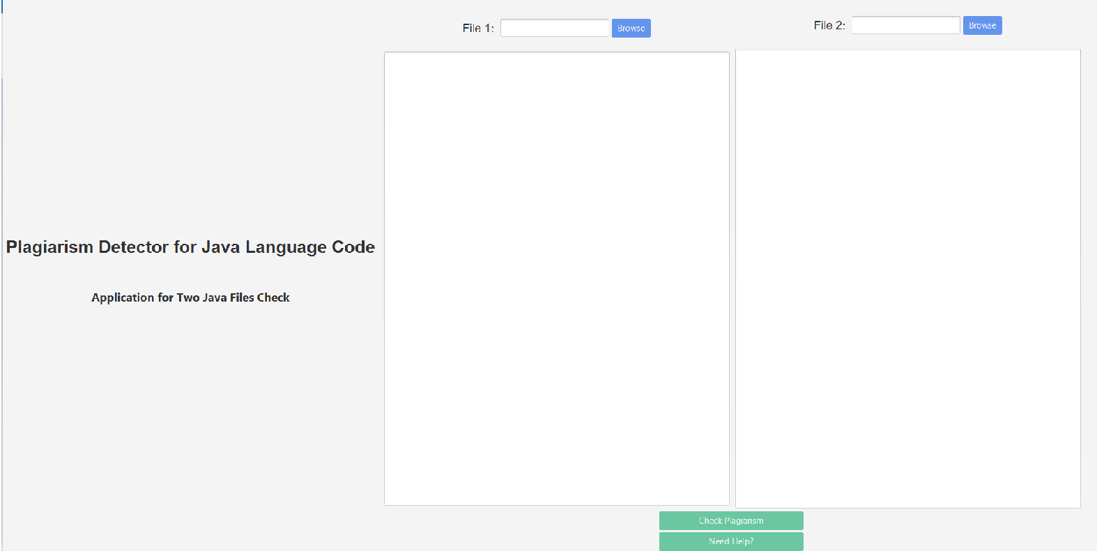
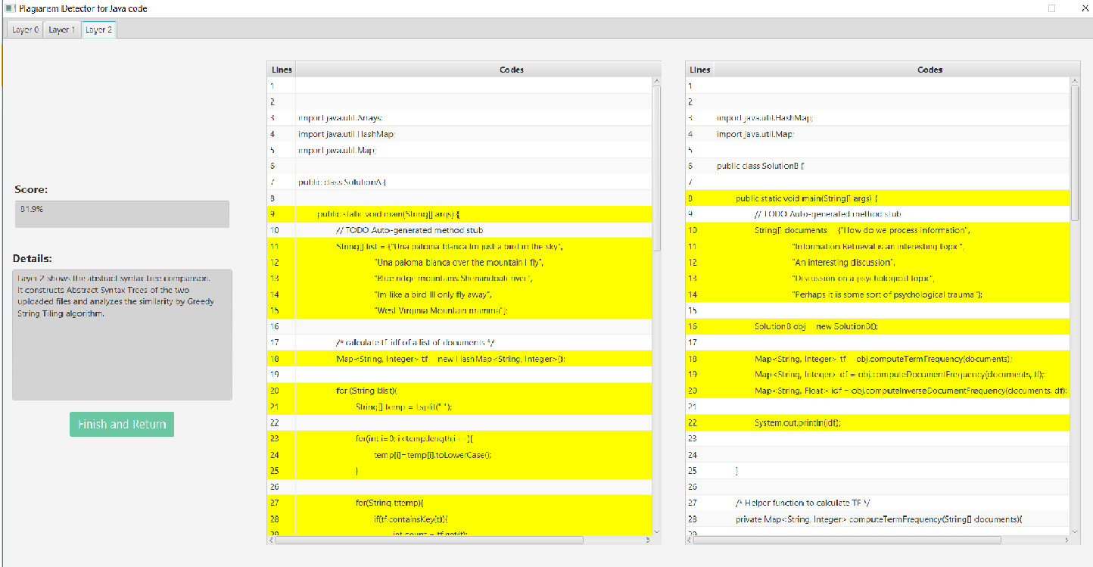
UI

Slide 13
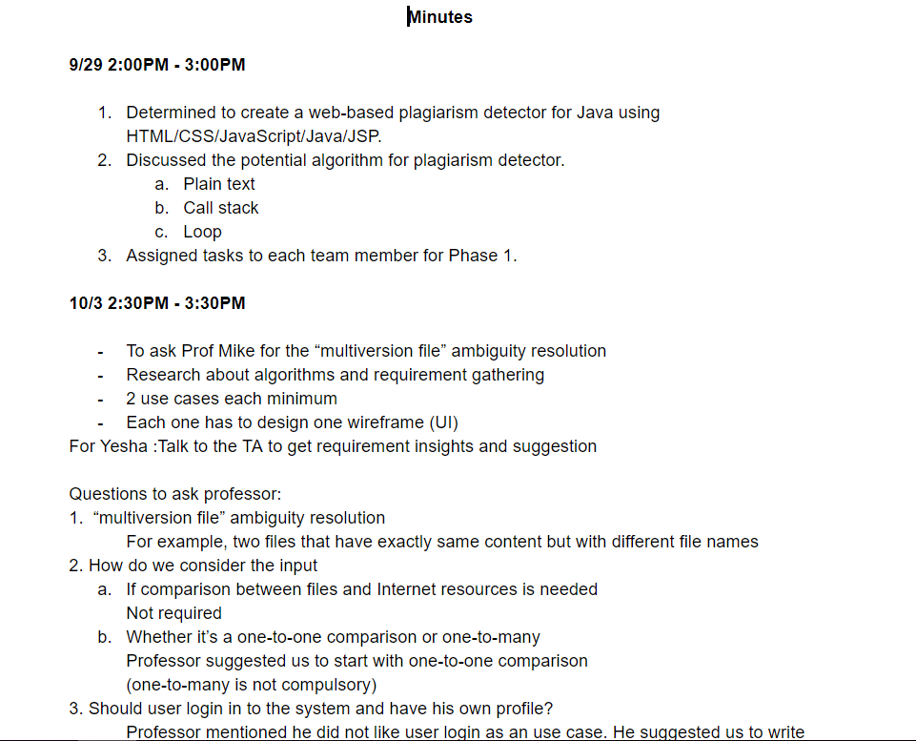
Team Management

Slide 14
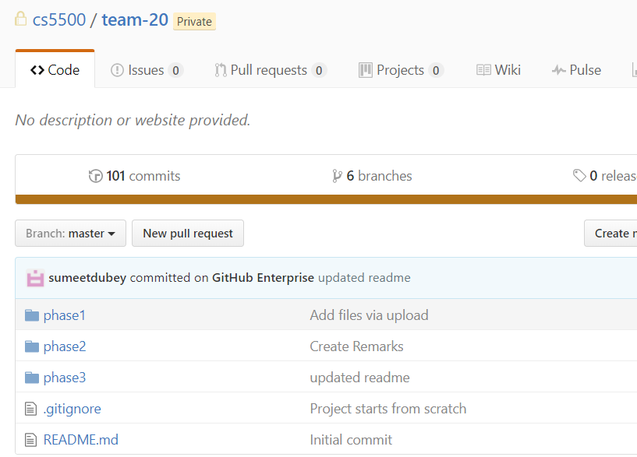

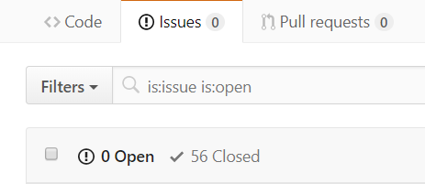
Team Management

Slide 15
Limitations and Enhancements
Our application only supports two Java files comparison for now
Can be extended to compare two entire Java projects in the future easily
User login functionality can be added and a database can be added for each user to save the history
UI can be improved

Slide 16
Infrastructure & Tools
Eclipse IDE
Eclipse JDT
Github
Google Drive
Maven
Javafx
JUnit
Java

Slide 17
Reference
JDT Documentation: https://www.eclipse.org/jdt/
L. Prechelt, G. Malpohl and M. Philippsen, “Finding “Plagiarisms among a Set of Programs with JPlag”. Journal of Universal Computer Science 8(11) pp. 1016-1038 (2002)
Liu, Cheng-Long, et al. "AST-based plagiarism detection method." Computer Engineering and Design 33.4 (2012): 1660-1664.
Michael J. Wise. String similarity via greedy string tiling and running Karp-Rabin matching. Dept. of CS, University of Sydney, ftp://ftp.cs.su.oz.au/michaelw/doc/RKR GST.ps, December 1993.
Paterson, Mike, and Vlado Dančík. "Longest common subsequences." Mathematical Foundations of Computer Science 1994 (1994): 127-142.

Slide 18
Thank You
JIALIN GAO
SUMEET DUBEY
WENJUN LI
YESHA JOSHI

